Slide 1


A project presentation on
A Blockchain based cryptocurrency
and development of an e-wallet
By- Guide
Pranav Waikar (B150574350) Mr. Sudam Pawar
Pratik Deshmukh (B150574336)
Rohan patel (B150574346)
Aditi kulkarni (B150574264)
Department of Computer Engineering
STES’s Sinhgad Institute of Technology and Science, Narhe, Pune

Slide 2
Today’s discussion aims …
—Introduction
—Motivation
—Challenging Issues
—Background
—Literature Survey
— Gap analysis
—Problem definition
—Feasibility study
—Proposed Architecture
—Mathematical Model & State Diagram
—Modeling & SRS
—Activity per objective
— Algorithms & UML diagrams
— Conclusions
— References

Slide 3

Member 1
Bio – Data : Personal Information
Roll No | B14COB70
Name of Student | Pranav Kiran Waikar
Date of Birth | 10/02/1997
Address | 4740, near bhgyashree lodge,
Lane | nirfarake lane, Maliwada,
City District | Ahmednagar
Tal Dist State Pin | 414001
Email id | pranavwaikar@gmail.com
Mobile No. | 7066506779

Slide 4
Project Associate No 1
Academic Track Record
Class | Sem | Year of Adm | % Marks | Remark
F. E. | I | 2014 | 60.00 | First class
 | II | 2015 | 55.28 | Second class
S. E. | I | 2015 | 62.22 | First class
 | II | 2016 | 65.06 | First class
T. E. | I | 2017 | 74.00 | Distinction
 | II | 2018 | 66.93 | Distinction
B. E. | I | 2018 | 70.00 | Distinction

Slide 5
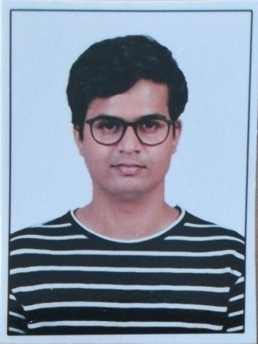
Member 2
Bio – Data : Personal Information
Roll No | B14COB19
Name of Student | Pratik Chandrasen Deshmukh
Date of Birth | 17/11/1996
Address | Flat no.28, Indica-D/3J, Aditya Garden City, Warje
Lane
City District | Pune
Tal Dist State Pin | 411058
Email id | viratpratik@gmail.com
Mobile No. | 7769955437

Slide 6
Project Associate No 2
Academic Track Record
Class | Sem | Year of Adm | % Marks | Remark
F. E. | I | 2014 | 68.8 | Distinction
 | II | 2015 | 68.7 | Distinction
S. E. | I | 2015 | 65.7 | Distinction
 | II | 2016 | NA
T. E. | I | 2017 | 60.4 | First class
 | II | 2018 | NA
B. E. | I | 2018 | NA

Slide 7
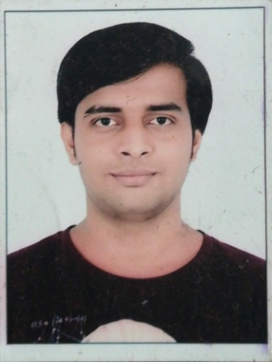
Member 3
Bio – Data : Personal Information
Roll No | B14COB52
Name of Student | Rohan Patel
Date of Birth | 19/05/1997
Address | 104 Satyanarayan Society
Lane | Bhestan, Surat
City District | Surat
Tal Dist State Pin | 395023
Email id | rhnptl79@gmail.com
Mobile No. | 8460351547

Slide 8
Project Associate No 3
Academic Track Record
Class | Sem | Year of Adm | % Marks | Remark
F. E. | I | 2014 | 55.70 | Second class
 | II | 2015 | 58.62 | Second class
S. E. | I | 2015 | 57.30 | Second class
 | II | 2016 | 60.30 | First class
T. E. | I | 2017 | 60.80 | First Class
 | II | 2018 | 60.55 | First Class
B. E. | I | 2018 | 60.50 | First class

Slide 9
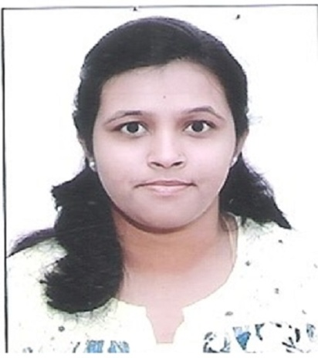
Your I card
Size Photo
Member 4
Bio – Data : Personal Information
Roll No | B14COB38
Name of Student | Aditi Kulkarni
Date of Birth | 02/01/1998
Address | Sushiladevi nagar,juna Ausa road
Lane | Adarsh colony, Latur
City District | Latur
Tal Dist State Pin | 413512
Email id | adi21kulkarni@gmail.com
Mobile No.

Slide 10
Project Associate No 4
Academic Track Record
Class | Sem | Year of Adm | % Marks | Remark
S. E. | I | 2015 | 60.57 | First Class
 | II | 2016 | 60.28 | First Class
T. E. | I | 2017 | 70.46 | Distinction
 | II | 2018 | 66.53 | Distinction
B. E. | I | 2018 | 66.09 | Distinction

Slide 11
Introduction
If we take a look around us, we are surrounded by Block Chains.
Unlike regular currencies, crypto currencies are secure, trusted and have a decentralized autonomous ecosystem.
The distributed ledger technology provides solid base for our autonomous system.
Block chain based crypto currency has been approved in Dubai to be used as a valid currency and using crypto currency for its daily transactions.

Slide 12
Motivation
The blockchain systems have ability to operate independently without any central management.
Eg. bitcoin successfully bypassed central banking system.
The big players are now interested in using block chain
i.e. Microsoft Azure, Apache open chain.
Block chain based crypto currency is still in its budding state and has a lot of scope for development & contribution.

Slide 13
Challenging Issues
Accessibility:- Once the private access keys are lost, they cannot be recovered since they are unique and cannot be regenerated.
Legality:- Block chain based crypto currencies are seen as black market entities and are not yet seen as a legal form of currency.
No regulatory authority:- As these systems are not owned by any authority, the stake holders of the system suffers the loss.

Slide 14
Background
What is block chain?
Open decentralised database of every transaction involving value & stored as immutable and unchangeable records.

Slide 15
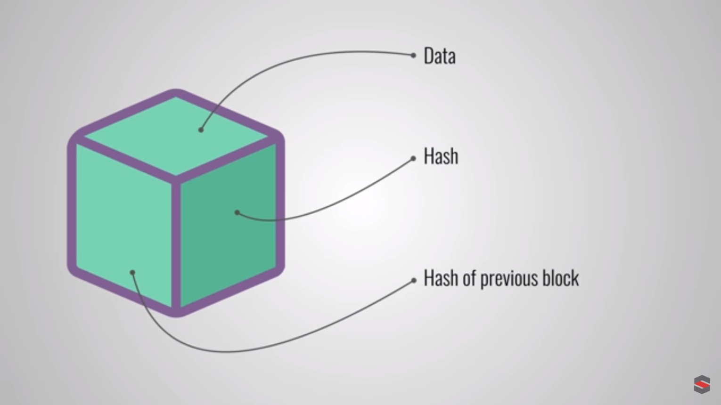
Background
What is a block?

Slide 16
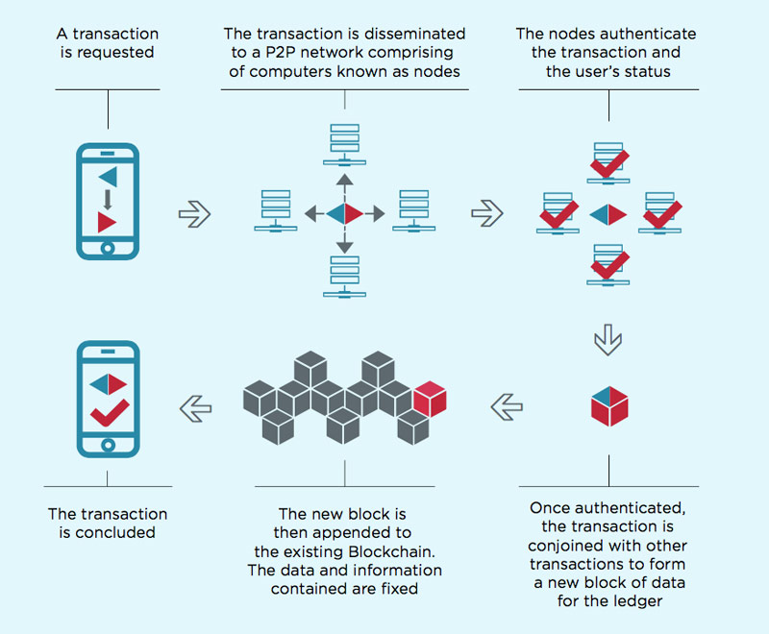
Background
How block chain works?

Slide 17
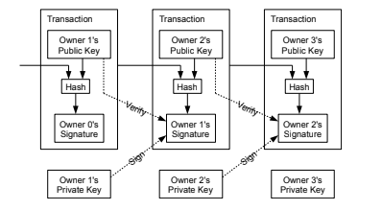
Background
Transaction Verification:

Slide 18
Sr no | Paper title/idea | General idea of paper | Advantage & Limitation
1 | Blockchain and Cryptocurrencies: Model, Techniques, and Applications [2018] | A survey of current crypto currencies to understand block chain & its different types. | Advantages: Provides different incentive models , ecosystem & applications of block chain. Explains block chain in layered architecture. Limitations: Does not provide any solid architecture for its stated application.
2 | A Brief Survey of Cryptocurrency Systems[2017] | It evaluates the strengths, weaknesses, and possible threats to all major mining strategy. It outlines how Crypto currencies mine, where they have comparable performance and assurance, and where they have unique threats and strengths. | Advantages: 1. Currently, major Crypto currencies use Proof of Work, Proof of Stake or a combination of the both for mining. 2.A combination of the both is found to be effective. 3.Typically memory-intensive hash functions have been found to be faster mining algorithms. Limitations: A majority of hash algorithms are CPU-intensive and the others are memory intensive. 2.While Proof of Work is resource intensive, Proof of Stake cannot act independently. 3. Crypto currencies are still experimenting with their mining protocols and algorithms to optimize their performance. No full proof algorithm has been found yet.
3 | Blockchain: Future of Financial and Cyber Security[2016] | This paper explains the concept, characteristics, need of Blockchain and how Bitcoin works. It attempts to highlights role of Blockchain in shaping the future of banking, | Advantages: 1.Decrease in device cost 2.Increases computing power Limitations: 1.If any attack done by attacker then there will be loss of all bit coins,we cant recover it because government is not involved in .

Slide 19
Sr no | Paper title/idea | General idea of paper | Advantage & Limitation
4 | Bitcoin: A Peer-to-Peer Electronic Cash System[2008] | A distributed peer to peer system working under blockchain framework. | Advantages: Cryptocurrency without any central authority. Successful POW mechanism. Limitations: The cost of POW consensus protocol will keep increasing as more people join the network.
5 | Trust Your Wallet : a New Online Wallet Architecture for Bitcoin [2017] | It introduces a wallet which is highly secured by Multiple signature. | Advantages: The scalability of disaster recovery center Limitations: If we lost one of key then we are not able recover that key .
6 | A survey on the security of block chain systems [2017] | Detail survey of the security issues in current systems and existing solutions | Advantages: A careful comparison between bitcoin and ethereum. Different aspects of system vulnerability Limitations: Cryptocurrency will need more methods to achieve security and privacy.

Slide 20
Summary of literature review
Crypto currencies use blockchain as base technology.
To promote cryptocurrency, reward mining is used.
Cryptocurrency is future of financing and cyber security.
E-wallets need several layers of security for proper functionality.

Slide 21
Gap analysis
There is a need of currency with proof-of-authority but without central point of failure.
Generalized public block chain API.
A crypto with hybrid consensus protocol.
A secure and high availability e-wallet for easy to facilitate transactions.

Slide 22
Problem Definition
Problem Statement:-
To create a de-centralized blockchain based crypto currency and an e-wallet to access currency.
Objectives:-
Create a generalized blockchain API.
Use the API create a new cryptocurrency model.
Implement a secure and high availability e-wallet for transactions.

Slide 23
Activity per objective
Create a generalized blockchain API(17-12-2018 to 26-12-2018)
Understand concepts of blockchain.
Decompose the concepts, identify object and relations to generate class diagram.
Use the API create a new cryptocurrency model(27-12-18 to 6-1-19)
Identify transaction parameters and output format.
Create a Synchronize transaction pool across the blockchain.
Integrate wallet model and transactions.
Implementation of e-wallet(7-1-2019 to 3-2-2019)
Design simple user friendly GUI.
Integrate e-wallet with cryptocurrency.
Add key management services.
Provide additional tools for user.

Slide 24
Feasibility study
Market feasibility- There is a visible market space for a new hybrid blockchain which is more secure than its predecessors.
Technical feasibility- The current technology provides sufficient operational storage, processing and bandwidth capabilities.
Financial feasibility- As the number of users increases, the token value of the cryptocurrency increases.

Slide 25
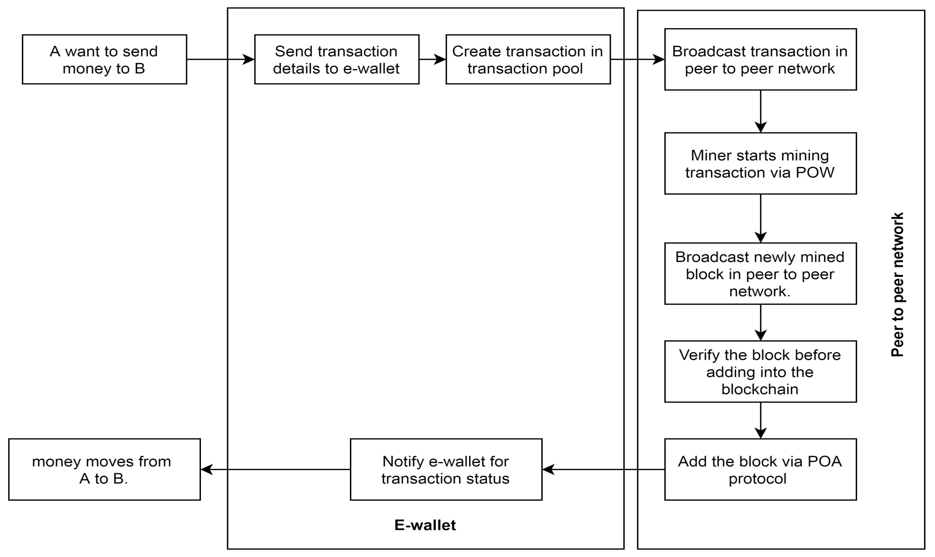
Proposed architecture

Slide 26
Modelling & Interfaces
SDLC :
Incremental model
Software interfaces :
Front-end: HTML,CSS,Javascript
Back-end: MongoDB,Node.JS,Express

Slide 27
Requirements
Hardware & software requirements:
Processor: Intel core 2 duo & above
Speed: 2.4GHZ
RAM: 4GB or above
Hard disk: 20GB or above
Operating system: Windows 7 or above, Linux, MAC.

Slide 28
Algorithms used
SHA-256
Elliptical curve cryptography: secp256k1 standards of efficient crypto prime 256bit Kabbalah version 1
UUID

Slide 29
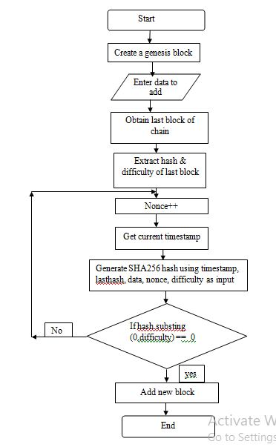
Algo: Dynamic mining difficulty

Slide 30
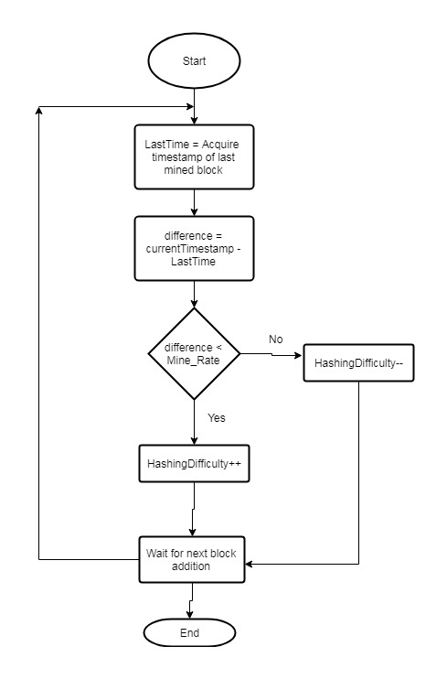
flowchart: Dynamic mining difficulty

Slide 31
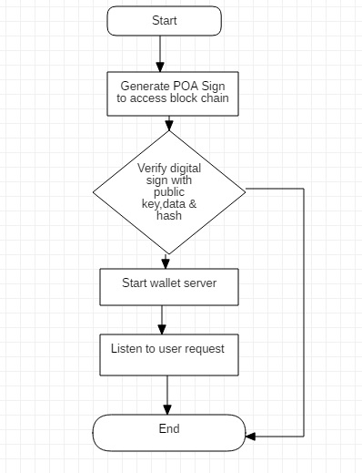
Wallet flowchart

Slide 32
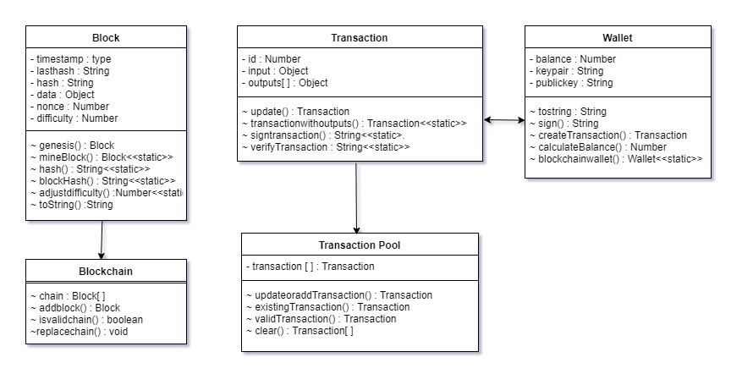
Class diagram

Slide 33
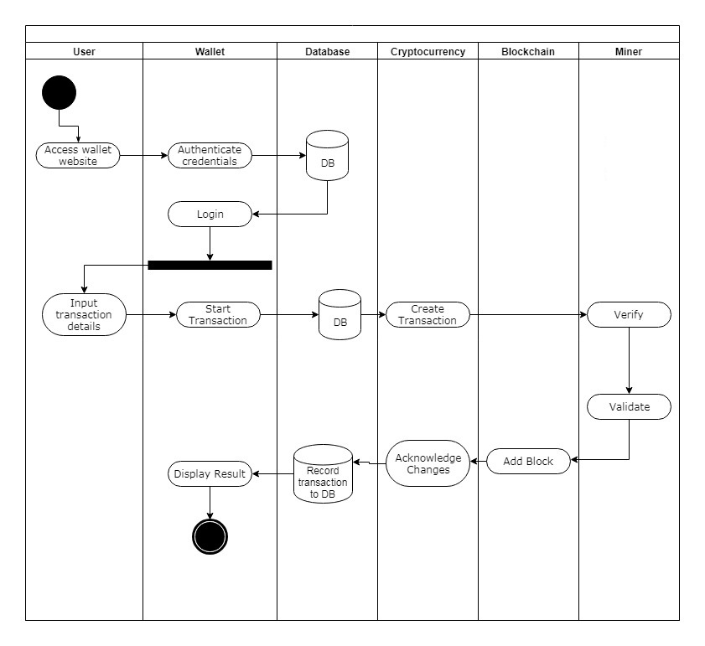
Activity diagram

Slide 34
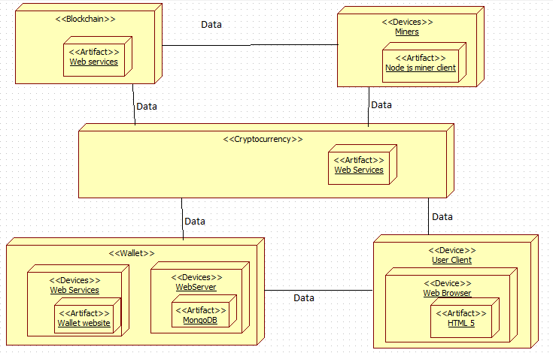
Deployment diagram

Slide 35
Results
A generalized blockchain API was created which could be used to create various project models like voting systems, crypto currencies etc.
A cryptocurrency model was created using the above stated blockchain API with higher security, robustness and availability.
An e-wallet was designed with reference to the cryptocurrency model to access and control the currency transactions.
The system was deployed over the cloud platform, which showcased reliable speed, performance and scalability of the system.

Slide 36
Conclusions
Thus we can see that there is a need of a de-centralized regulated transaction token(currency) without a central point of failure.
Also a generalized block chain API is needed which can further be used for purpose other than crypto currency.
And finally, we have identified data objects, their attributes, relationships and matched the objects with their respective classes & responsibilities.

Slide 37
References
References:
[1] Y. Yuan, S. Member, and F. Wang, “Blockchain and Cryptocurrencies : Model, Techniques,and Applications,” IEEE Trans. Syst. Man, Cybern. Syst., vol. PP, pp. 1–8, 2018.
[2] U. Mukhopadhyay, A. Skjellum, O. Hambolu, J. Oakley, L. Yu, and R. Brooks, “A Brief Survey of Cryptocurrency Systems.”
[3] S. Singh, “Blockchain : Future of Financial and Cyber Security,” pp. 463–467, 2016.
[4] S. Nakamoto, “Bitcoin: A Peer-to-Peer Electronic Cash System,” Www.Bitcoin.Org, p. 9,2008.
[5] F. Zhu et al., “Trust Your Wallet : a New Online Wallet Architecture for Bitcoin,” 2017.
[6] X. Li, P. Jiang, T. Chen, X. Luo, and Q. Wen, “A survey on the security of blockchain
systems,” Futur. Gener. Comput. Syst., 2017.

Slide 38
THANK YOU!
Thank you for listening!

